Slide 1



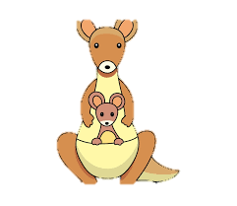

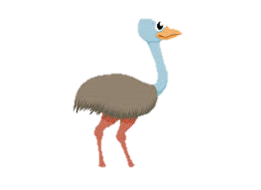
Welcome to
Australia Class!

Slide 2

Your teaching team…
Miss Bessell – Class Teacher
Miss Mac- Class Teaching Assistant (Mon, Tue am)
Mrs Foote- Class Teaching Assistant (Wed, Thurs, Fri am)
Mrs Gray, Mrs Man – PPA cover (Forest school, Tuesday PM)

Slide 3
The Year ahead…
Term 1 – Healthcare Heros
History topic around how healthcare has changed thanks to our STEM heroes.
Term 2 – Girl power
Learn all about Rosa Parks + Emmeline Pankhurst
Term 3 – Land Down Under
Geography topic, all about Australia and our local area.
Term 4 – London’s burning
History focus on the Great Fire of London.
Term 5 – Midsummers Night’s Dream
Shakespeare, sculpture making
Term 6 – What makes Bristol Brilliant?
John Cabot and the history of Coalpit Heath

Slide 4

Trips!
Term 3– Westonbirt Arboretum
Term 6- we are the curious
Any other trips will be made aware to you.

Slide 5

Key information
Please ensure your child brings their readings books and record
and water bottle everyday.
Children are provided with snacks so please do not send your
child in with these. We are a NUT FREE SCHOOL.
All uniform should be named.
PE kits – Gold top, black bottoms (shoes children can do up independently)
PE day are Wednesday and forest school on Tuesday’s

Slide 6
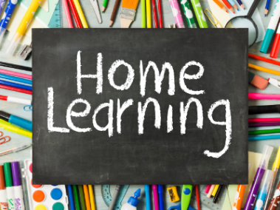
Children should be reading at home 5 times a week.
They should be reading each book 3 times. This will enable them to read fluently and understand what they are reading.
Talk about the book with your child.
Books checked weekly- Change date written in record.
Library books will be changed on Wednesday’s.
Home learning:
A phonics activity and maths activity that will be given out on Friday and brought back the following Thursday, this will get your child home learning heroes time.

Slide 7
Communication
Australiaclass@sgmail.org.uk
Direct email to me.
ManorPrimary@sgmail.org.uk-
For emergencies and absences.
SLT on gate in the morning.
I will be on the gate in the afternoon.

