Slide 1
Welcome to
Europe Class!

Slide 2
Your teaching team…
Miss Walker – Class Teacher
Mrs Foxall-Giess – Class Teaching Assistant
(Monday and Wednesday mornings)
Miss Lambe – PPA cover (PE – Tuesday afternoon)
Mrs Gray – PPA cover (RE – Tuesday afternoon)

Slide 3
The Year ahead…
Term 1 – Mad about Maya
The Ancient Maya, South America, teeth and digestion
Term 2 – Eurovision
Europe and Food chains
Term 3 – Home Sweet Habitat
North and South America, living things in their habitats and biomes
Term 4 – The Shang and Fang
The Shang Dynasty and plants
Term 5 – It’s the Sound of the Greeks
The Ancient Greeks, sound and geographical skills
Term 6 – What makes Bristol Brilliant?
Local history study – aviation in Bristol, map skills and working scientifically.
Further details will be sent out in the curriculum news letter sent out at the beginning of term.

Slide 4
Trips!
Bristol Tobacco Factory - 18th December
The Wild place project – 20th January
Bristol Aerospace museum – 7th July
We hope to add some further trips but these are yet to be finalised

Slide 5
Key information
Water bottles, reading record
Snacks (no nuts also)
The snack should be a piece of fruit or cereal bar
Named uniform
If any unnamed uniform is left in the classroom, it will be moved to lost property in the reception.
P.E kits and P.E days – Tuesday
Gold top and plain black bottoms
Hair should be tied up
No jewellery
Forest school on Thursday

Slide 6
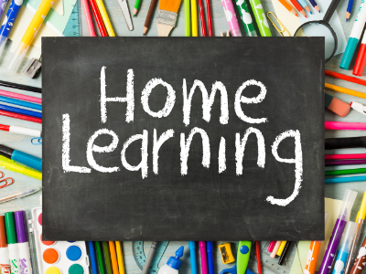
Reading expectations
Your child should read 5 or more times a week
out loud to an adult to help build fluidity and
confidence
Spelling practise
Your child should practise the spelling list in
their home learning book weekly
Times Table Rock Stars
Your child should complete 20 minutes of TTRS each week – which is 20 minutes of garage
Books checked weekly
Please ensure that your child brings their home learning book with their spellings and has completed their TTRS by Thursday as these will be checked and returned to them on Friday.
Reading records will also be checked on Thursday and returned at the end of the day.

Slide 7
Communication
Class email address
EuropeClass@sgmail.org.uk
ManorPrimary@sgmail.org.uk
At least one member of the Senior Leadership team will be on the gate at the beginning of the day.
I will be on the gate at the end of the day.

Slide 8
Thank you for coming!
You are welcome to have a little look around the classroom and I’ll be available for questions!

