Slide 1

Welcome to
South America Class!

Slide 2

Your teaching team…
Mrs Sweet – Class Teacher
Mrs Jones –Teaching Assistant (Monday - Wednesday morning)
Mrs Molina – Tuesday morning & Spanish & PPA cover
Mr Prichard – PPA cover
Mrs Sherwood, Mrs Mann, Mrs Claridge – additional support
Mrs Gray - SENDCO

Slide 3
The Year ahead…
Term 1 – The Romans
Term 2 – Extreme Earth
Term 3 – What time do you call this?
Term 4 – Darwin’s Discoveries
Term 5 – The lungs of the Earth
Term 6 – What makes Bristol brilliant?

Slide 4

Trips
5th October – Carleon
Term 2 – Whole school theatre trip
14th – 18th June – Camp (Okehampton)

Slide 5

Key information
Please ensure your child brings their reading record and water bottle everyday.
Healthy snack for break time please. Fruit or cereal bars. NO NUTS.
All uniform should be named.
PE kits – Gold top, black. Hair tied back and all jewellery removed.
PE days are Tuesdays and Friday.

Slide 6
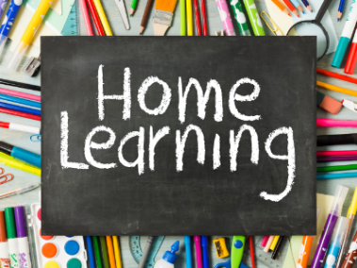
Please ensure your child brings their Home learning books in every Thursday. Homework will then be marked and sent back out on Fridays.
Homework routine in place before Secondary school will really help.
READING
Children should be reading at home a minimum of 5 times a week.
Ideally, they should be reading aloud to an adult. This will enable them to read fluently and understand what they are reading. Please talk to your child about the book they are reading and ask them questions where necessary. Reading logs will be checked weekly on a Thursday.
MATHS
Maths sheet each week to be completed. Will relate to our learning in school.
TTRS is not required but if your child wants (or needs) to practise – login details are in home learning books.
SPELLING AND GRAMMAR (SPAG)
Grammar sheet each week to be completed.
Spellings will be sent out at the start of the term for your information. No requirement to record any practise of these but it will help their spelling knowledge if they can practise these at home as well as in school.
Home learning hero time
Children that complete the above activities each week will continue to receive ‘Home Learning Hero’ time. Any children who were not able to complete this at home, will be given support from an adult in school to do so.

Slide 7
Communication
Southamericaclass@sgmail.org.uk
ManorPrimary@sgmail.org.uk
If urgent please email school, however I will check class emails daily.
SLT on gate in the morning.
I will be on the gate in the afternoon.

Slide 8
SATS and camp
Will be separate meetings closer to the time about both of these.
SATS preparation – do the home learning and good sleep routine.
Any questions or concerns about these that you wish to discuss with me before the meetings, please get in touch.

Slide 9


