Slide 1
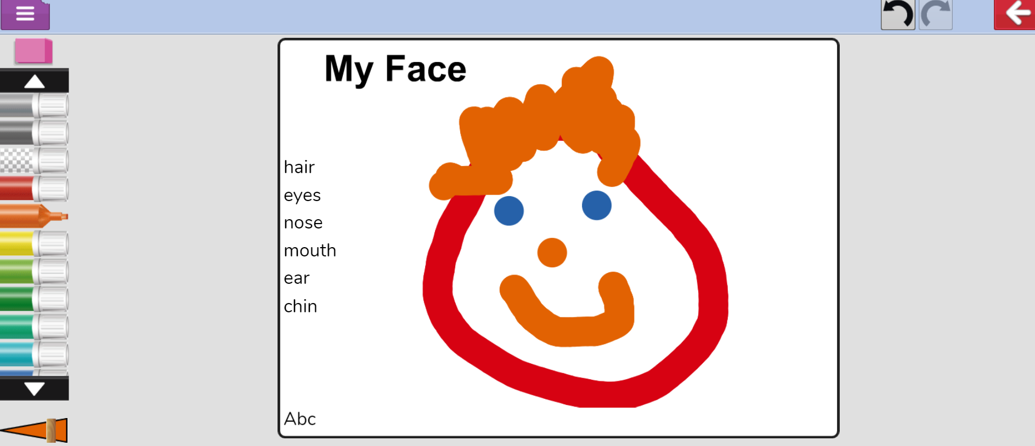
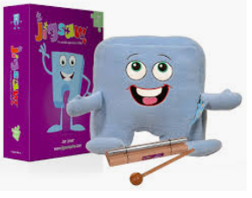
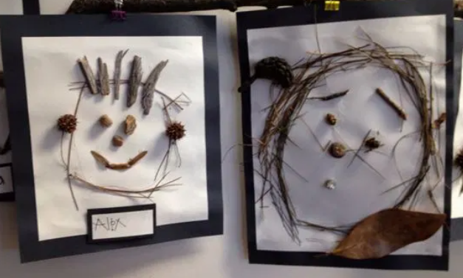
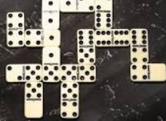
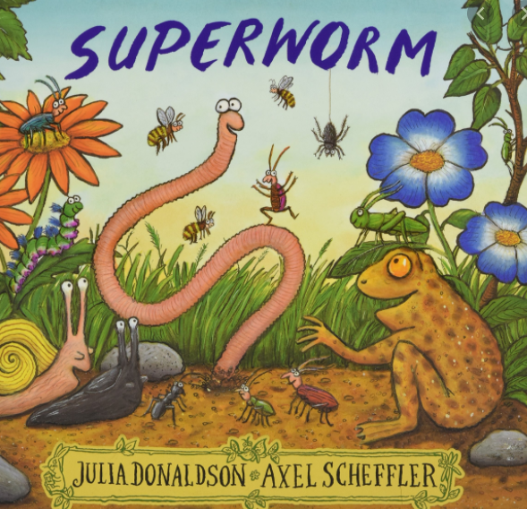
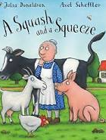
YR LEARNING OVERVIEW T1 Termly value: Thankfulness Learning Gem: Ruby Power
Personal, Social and Emotional
Expressive Arts and Design
Create portraits of myself using different types of media
Join in with songs to explore the beat and tempo: nursery rhymes, counting songs
Join in with musical instruments (tap sticks, tambourines, drums) to replicate beat and tempo: How do you do?
Using Purplemash 2simple2create and ActivInspire, create portraits using a paint programme: select different paint colour and effects.
Vocabulary: beat, rhythm, tempo, nursery rhyme, rhyme,
click, drag, paint effects.
Being me in my world & celebrating differences
School rules
How to be kind and gentle in class
My rights and responsibilities
My identity
I can talk about something I am good at and how it feels.
Similarities between people in my class.
One way in which I feel special or unique.
How people have different homes & families.
How to make friends.
How to stand up for myself by using words.
Vocabulary: ready, respectful, safe, kind, gentle, caring,
sharing, rules, responsibilities, behaviour, home, family, culture,
different, same,
Communication, Language & Literacy
Rhyme and beginning sounds
Identify different sounds
Play I spy and identify initial sounds in words
Join in with nursery rhymes, songs and chants.
Learn stories off by heart: Hairy Maclary, Julia Donaldson
Handle books carefully
Recognise my name
Recall s,a,t,p,i,n,m,d,g,o,c,k,e,u,r,b, sounds
Read word list 1 - 5 by blending sounds together (overleaf)
Read tricky words: I no go
Talk about pictures I have drawn
Try to write my name
Learn how to write letters for the sounds learnt using pre-cursive script (see Letterjoin below)
Learn about how to show active listening skills: stop what you are doing, looking at the person talking, respond appropriately.
Nursery rhymes:
https://www.bbc.co.uk/teach/school-radio/nursery-rhymes-songs
Julia Donaldson online stories:
https://www.bbc.co.uk/programmes/p06vkmht
Handwriting support (Letterjoin)
https://www.letterjoin.co.uk/log-in.html username: lj3333 password: home
Maths
Match, sort and compare objects recognising what is the same and what is different.
Measure – What can I measure?
Comparing size, mass and capacity
Pattern – copy, continue and create simple patterns.
Write numbers to 6
Knowledge & understanding of the world
I can talk about:
My family and who lives with me
(who lives with me in my house? Who are the
special people in my life? What do they do? Who are
my grandparents)
My likes and dislikes
(food, sounds, games, music etc)
talk about what makes me who I am
(What I look like and who in my family looks like me. I
can talk about the things I am good at)
Who is in my school community and what do they do?
Vocabulary: same, different, set, sort, bigger, smaller, larger, longer, shorter, taller, heavier, lighter, less, more, pattern
RE & Spirituality
What are our Christian Values and why are they important?
I can talk about:
What our Values are and what I understand about them.
When I have used our Values.
Why our Values are important.
Vocabulary: rhyme, sounds, phoneme, blend, letters, story, fiction
Vocabulary: family, community, Mother/Mum Father/Dad
Parent Sister Brother Grandmother/Nana, Grandfather/Papa Auntie, Stepmother/father/sister/brother Uncle Cousin, Head Teacher, Cook,
Teaching Assistant, Teacher, Lunch Break Supervisor, Lollipop lady,
Caretaker
Vocabulary: thankfulness, grateful, compassion, kindness, honesty, truth, forgiveness, apologise, friendship, courage, brave, bravery.
Physical Development
Gross motor skill opportunities: Introductory unit: Moving around an indoor space safely. Awareness of our bodies in a space.
Fine motor skill opportunities: using scissors, brushes, pens, pencils, beads, pegs, tongs, dough and threading activities.

Slide 2
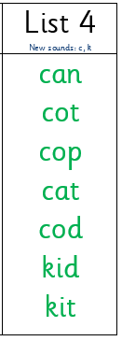
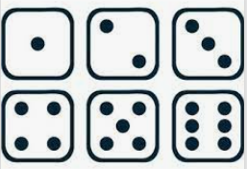
Knowledge
By the end of this term I will know:
The three school rules; Ready, Respectful and Safe.
What our School Values are, what they mean, and why they are important to us.
My surname.
Maths – Recall Facts to learn at home
I can count forwards from 0 to 6 and backwards from 6 to 0
I can recognise numbers to 6 and place them in order.
Know the dots on a dice automatically by sight rather than counting.
Curriculum Drivers
Arts: We will be using different media to make portraits this term. We will be trying to replicate the line drawings of Picasso.
Spirituality: Who am I? What makes me, me?
Community: Meet the Manor team: Lollypop Lady, Lunch-break Supervisor, School Administrator, Head Teacher and Deputy Head Teacher. What is their role? How can they help me?

