Slide 1
Welcome to
Asia Class!

Slide 2
Your teaching team…
Miss Spencer – Class Teacher
Mrs Foxall-Giess – Class Teaching Assistant (Tuesday mornings)
Mrs Cox - Class Teaching Assistant (Weds – Fri mornings)
Mrs Gray – PPA cover (RE, Tuesday PM)
Miss Lambe – PPA cover (PE, Tuesday PM)

Slide 3
The Year ahead…
Term 1 – Mad about Maya!
Term 2 – The Shang Dynasty
Term 3 – Home sweet habitat
Term 4 – Ask me about Asia
Term 5 – It’s the sound of the Greeks
Term 6 – What makes Bristol brilliant?

Slide 4
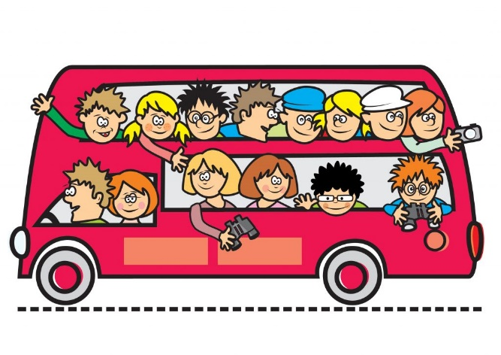
Trips!
18th December –Tobacco Factory whole school trip
20th January– Bristol Zoo Project trip
7th July– Aerospace trip (provisional date)
We will inform you of any date changes/trip details nearer the time.

Slide 5
Key information
Please ensure your child brings their reading
record and water bottle everyday.
Please ensure your child brings their Home learning books in every Thursday. Homework will then be marked, new sheets stuck in and sent back out on Fridays.
Please ensure your child brings in a healthy snack for break time. Fruit or cereal bars please. NO NUTS.
All uniform should be named.
PE kits – Gold top, black bottoms (shoes children can do up independently)
Hair tied back and all jewellery removed.
PE days are Tuesdays and Wednesday (swimming Terms 1 and 2).

Slide 6
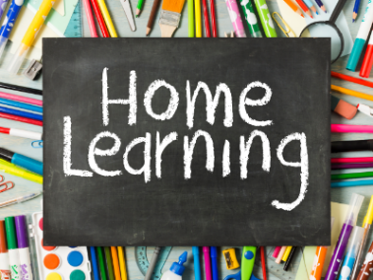
Children should be reading at home 5 times a week.
They should be reading aloud to an adult. This will enable them to read fluently and understand what they are reading.
Please talk to your child about the book they are reading and ask them questions where necessary.
Spelling practise – word lists are in each home learning book. Practice writing each word in different ways. Then put into sentences.
TT Rockstars – your child should complete 20 mins of Garage activities weekly (Term 1 and 2).
After Christmas TT Rockstars will change to 5 soundcheck games and 15 mins garage to prepare for TT Check in June.
Books checked weekly (A member of staff will read with your child every 2 weeks)

Slide 7
Communication
Asiaclass@sgmail.org.uk
ManorPrimary@sgmail.org.uk
If urgent please email school, however I will check class emails daily.
SLT on gate in the morning.
I will be on the gate in the afternoon.

Slide 8
Maternity
I will be leaving to have a baby during Term 2. Details of my cover will be announced nearer the time, any questions or concerns please come and speak to me ☺

