Slide 1
Welcome to
Asia Class!

Slide 2
Your teaching team…
Miss Spencer – Class Teacher
Mrs Foote – Class Teaching Assistant (Every morning)
Mrs Mann - Class Teaching Assistant (Tuesday and Wednesday mornings)
Mrs Gray – PPA cover (RE, Thursday PM)
Miss Lambe – PPA cover (PE, Thursday PM)

Slide 3
The Year ahead…
Term 1 – Walk like an Egyptian!
Term 2 – River deep, Mountain high
Term 3 – Let’s Settle!
Term 4 – 1066
Term 5 – It’s Electrifying!
Term 6 – Ship, shape and Bristol fashion.

Slide 4
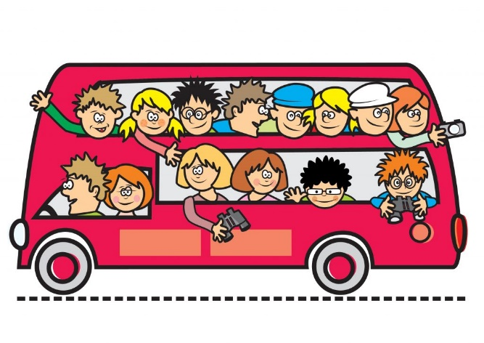
Trips!
12th September – Egyptian BANG! Day
12th October – Bristol Museum
12th December – Pantomime @ Bristol Hippodrome
We hope to book some further trips but these are yet to be finalised. We will inform you as soon as we know.

Slide 5
Key information
Please ensure your child brings their reading
record and water bottle everyday.
Please ensure your child brings their Home learning books in every Thursday. Homework will then be marked, new sheets stuck in and sent back out on Fridays.
Please ensure your child brings in a healthy snack for break time. Fruit or cereal bars please. NO NUTS.
All uniform should be named.
PE kits – Gold top, black bottoms (shoes children can do up independently)
Hair tied back and all jewellery removed.
PE days are Wednesday (swimming Terms 1 and 2) and Thursdays.

Slide 6
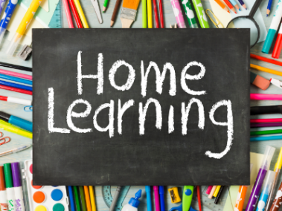
Children should be reading at home 5 times a week.
They should be reading aloud to an adult. This will enable them to read fluently and understand what they are reading.
Please talk to your child about the book they are reading and ask them questions where necessary.
Spelling practise – word lists are in each home learning book. Practice writing each word in different ways. Then put into sentences.
TT Rockstars – your child should complete 20 mins of Garage activities weekly.
Books checked weekly (A member of staff will read with your child every 2 weeks)

Slide 7
Communication
Asiaclass@sgmail.org.uk
ManorPrimary@sgmail.org.uk
If urgent please email school, however I will check class emails daily.
SLT on gate in the morning.
I will be on the gate in the afternoon.

