Slide 1
Welcome to
South America Class!

Slide 2
Your teaching team…
Miss Coult
Miss Lambe
Mrs Claridge Monday - Wednesday
Mrs Molina
Miss Lambe
Mrs Gray

Slide 3
The Year ahead…
Term 1 – We’ll meet again (Britain at War) and Electricity
Term 2 – Fairgrounds and Forces
Term 3 – Settlements (Stone Age and Iron Age)
Term 4 – Materials – properties and changes of materials
Term 5 – Space
Term 6 – Ship Shape and Bristol Fashion and living things and their habitats
Further details will be sent out in the curriculum newsletter sent out at the beginning of term

Slide 4
Trips!
STEAM (Tuesday 10th October 2023)
Life Skills (Thursday 23rd November 2023)
Bristol Hippodrome (Tuesday 12th December 2023)
Residential Okehampton Summer term

Slide 5
Key information
Your child will need to bring their water bottle and reading record daily
Your child can bring in a snack for them to eat at break time (such as fruit, veg or cereal bars)
We are a nut free school- so no nuts please!
Named uniform
If any unnamed uniform is left in the classroom, it will be moved to lost property by the office
P.E kits
Gold top and plain black bottoms
Hair tied up
No jewellery
P.E days
Mondays and Wednesdays
Forest school
Term 6

Slide 6
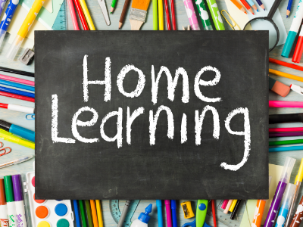
Reading expectations
5x a week at home- best for your child to read aloud to an adult
Spelling practise
Your child should practice the spelling list in their home learning books weekly
Times Tables Rock Stars
Your child should complete 20 minutes of TTRS a week- this is 20 minutes of garage
Books checked weekly
Please ensure your child brings in their home learning book with their completed spellings inside on Thursdays
They should have completed their 20 minutes of TTRS by Thursday too
Both your child’s reading record and their home learning book will be checked on a Thursday. Your child’s reading record will be returned on a Thursday and the home learning book on a Friday.

Slide 7
Key Year 6 information
SATs week 13th – 19th May 2024
Study aids – CPG Work books, information books
Amazon about £5

Slide 8
Communication
SouthAmericaClass@sgmail.org.uk – contact me
ManorPrimary@sgmail.org.uk – contact school urgently/throughout the day
SLT on the gate in the morning- they can take messages which will be given directly to me in the morning
Whoever is teaching your child in the afternoon will be on the gate at the end of the day.
If you would like your child to walk home on their own, please let me know via email so that all adults are aware when sending the children out at the end of the day.

Slide 9
Thank you!

