Slide 1

Welcome to
North America Class!

Slide 2

Your teaching team…
Miss Coult – Class Teacher
Mrs Sherwood –Teaching Assistant (Monday - Wednesday mornings)
Mrs Molina – Friday afternoon Spanish & PPA cover
Mrs Gray - SENDCO

Slide 3
The Year ahead…
Term 1 – The Romans
Term 2 – Extreme Earth
Term 3 – What time do you call this?
Term 4 – Darwin’s Discoveries
Term 5 – The lungs of the Earth
Term 6 – What makes Bristol brilliant?

Slide 4

Trips
5th October – Caerleon Roman Fortress, museum and baths
Term 2 – Whole school theatre trip
Music (ukulele) lessons start on Monday!

Slide 5

Key information
Please ensure your child brings their reading record and water bottle everyday.
Healthy snack for break time please. Fruit or cereal bars. NO NUTS.
All uniform should be named.
PE kits – Gold top, black. Hair tied back and all jewellery removed / or earrings covered (please can you provide the tape).
PE days are Wednesday and Thursday.

Slide 6
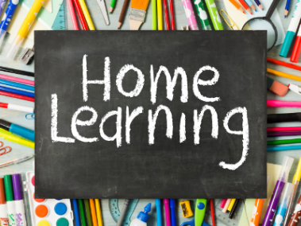
Please ensure your child brings their Home learning books in every Thursday. Homework will then be marked and sent back out on Fridays.
READING
Children should be reading at home a minimum of 5 times a week.
Ideally, they should be reading aloud to an adult. This will enable them to read fluently and understand what they are reading. Please talk to your child about the book they are reading and ask them questions where necessary.
Reading logs will be checked weekly on a Thursday – they should come to school each day.
MATHS
Times Tables Rock Stars
Your child should complete 20 minutes of TTRS a week- this is 20 minutes of garage
Log in details are in Home Learning books.
SPELLINGS
Word lists are in each home learning book. Practice writing each word in different ways. We will send out a list of ideas that you may wish to try!
Home Learning Hero time
Children that complete the above activities each week will continue to receive ‘Home Learning Hero’ time.
There is a Home Learning club on a Wednesday break / lunchtime for children to attend.
The library is available most break times if children would like to do spellings or reading during this time.

Slide 7
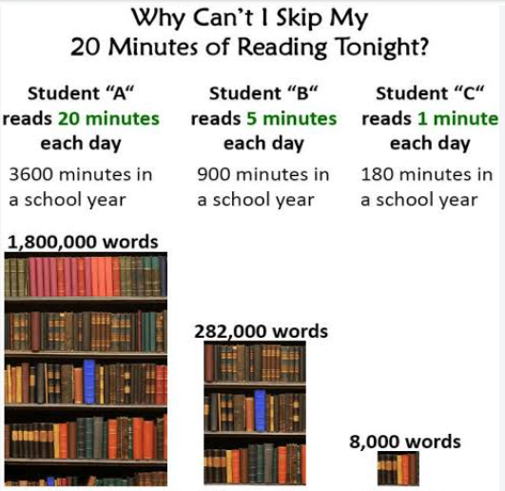

Slide 8
Communication
Northamericaclass@sgmail.org.uk
ManorPrimary@sgmail.org.uk
If urgent please email school, however I will check class emails daily.
SLT on gate in the morning.
I will be on the gate in the afternoon (apart from Friday – this term).

Slide 9


