Slide 1

Welcome to
Asia Class!

Slide 2

Your Teaching Team…
Miss Alderson – Class Teacher
Mrs Claridge – Class Teaching Assistant (Monday to Wednesday morning)
Mrs Jones – Class Teaching Assistant – Thursday and Friday morning
Mrs Mann – Class Teaching Assistant – Thursday and Friday morning
Mr Prichard – PPA cover – Wednesday afternoon

Slide 3
A little about me..

Slide 4
The Year ahead…
Term 1 – Mad about Maya
Term 2 –. Burning Questions
Term 3 – Home Sweet Habitat
Term 4 – It’s the sound of the Greeks
Term 5 – The Shang and The Fang
Term 6 – What makes Bristol brilliant?

Slide 5
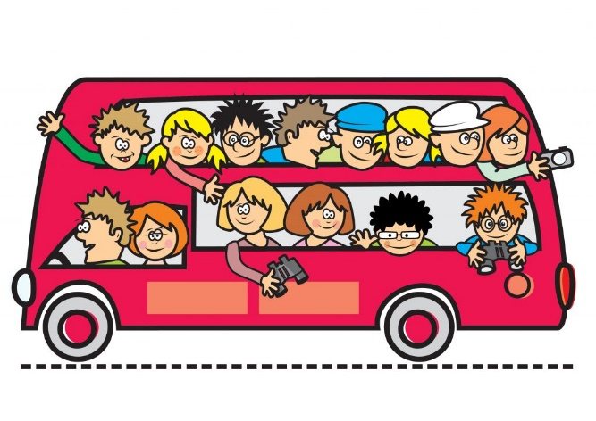
Trips and events
Term 2 - Theatre Trip
Term 3 – The Wild Place
Term 6 – Concorde Museum
We will inform you of any date changes/trip details nearer the time.
We do a sewing unit in Term 4 and pizza making in Term 6 – Help would be fantastic for these.
Reading Volunteers always welcome.

Slide 6

Key information
Please ensure your child brings their reading record and water bottle everyday.
Please ensure your child brings their Home learning books in every Thursday. These will be checked by Friday morning and handed back to the children. We will start homework from tomorrow. First column of spellings.
Please ensure your child brings in a healthy snack for break time. Fruit or cereal bars please. NO NUTS.
All uniform should be named.
PE kits – Gold top, black bottoms (shoes children can do up independently)
Hair tied back and all jewellery removed.
PE days are Monday and Wednesday (swimming Terms 1 and 2 and some of 3).

Slide 7
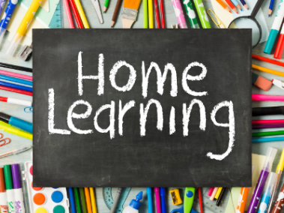
Children should be reading at home 5 times a week.
They should be reading aloud to an adult. This will enable them to read fluently and understand what they are reading.
Please talk to your child about the book they are reading and ask them questions where necessary.
Spelling practise – word lists are in each home learning book. Practice writing each word in different ways. Then put into sentences.
TT Rockstars – your child should complete 20 mins of Garage activities weekly (Term 1 and 2).
After Christmas TT Rockstars will change to 5 soundcheck games and 15 mins garage to prepare for TT Check in June.
Time Tables!!!!
Calculation Club Friday
Books checked weekly (A member of staff will read with your child every term. We do aim for more frequently)

Slide 8
Times Tables Focus this year.
Multiplication check at the start of June
25 questions – 6 seconds per question.
Random selection
Until Christmas, focus on learning and having a secure understanding of all tables up to 12.
After Christmas, focus on increasing speed.
In Class
Daily Times Table Test – 40 questions. Timed. Collect scores, Children try to beat their own scores. Not competing against anyone else.
MTC UR brainy practice regularly
Hit the button website
TTRS is critical. The format will change after Christmas.

Slide 9
Communication
Asiaclass@sgmail.org.uk
ManorPrimary@sgmail.org.uk
If urgent please email school, however I will check class emails daily. This isn’t always first thing in the morning,
SLT on gate in the morning.
I will be on the gate in the afternoon.

Slide 10
Any questions?

