Slide 1
Welcome to
North America Class!

Slide 2
Your teaching team…
Miss Hughes
Mrs Sherwood
Miss Honey
Miss Lambe
Mrs Gray

Slide 3
The Year ahead…
Term 1 – We’ll meet again (Britain at War) and Electricity
Term 2 – Fairgrounds and Forces
Term 3 – Settlements (Stone Age and Iron Age)
Term 4 – Materials – properties and changes of materials
Term 5 – Space
Term 6 – Ship Shape and Bristol Fashion and living things and their habitats
Further details will be sent out in the curriculum newsletter sent out at the beginning of term

Slide 4
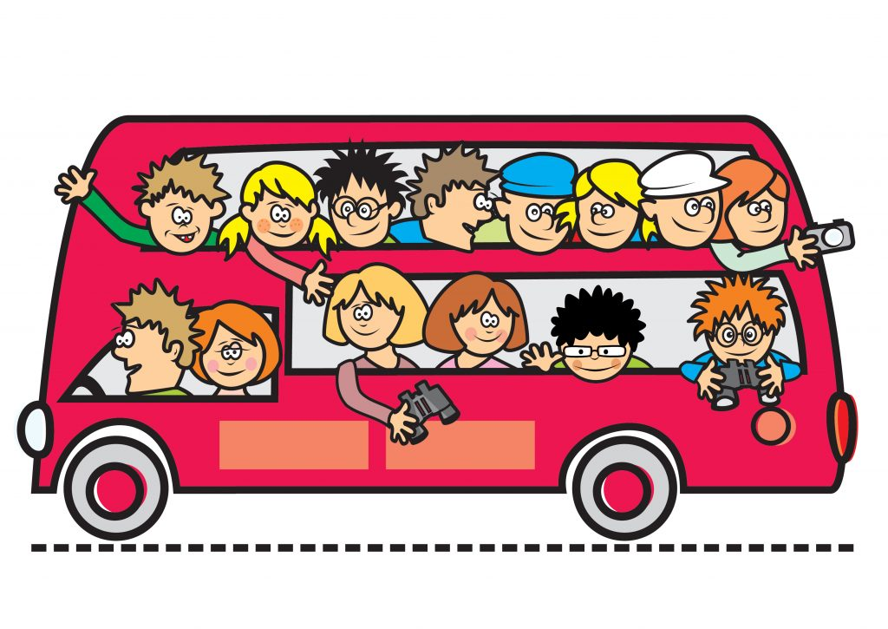
Trips!
STEAM (Tuesday 10th October 2023)
Bristol Hippodrome (Tuesday 12th December 2023)
Second class trip to be finalised- you will receive further information closer to the time

Slide 5
Key information
Your child will need to bring their water bottle and reading record daily
Your child can bring in a snack for them to eat at break time (such as fruit, veg or cereal bars)
We are a nut free school- so no nuts please!
Named uniform
If any unnamed uniform is left in the classroom, it will be moved to lost property by the office
P.E kits
Gold top and plain black bottoms
Hair tied up
No jewellery
P.E days
Mondays and Wednesdays
Swimming
Term 3 and Term 4
Forest school
Term 2

Slide 6
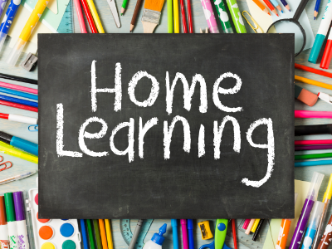
Reading expectations
5x a week at home- best for your child to read aloud to an adult
Spelling practise
Your child should practice the spelling list in their home learning books weekly
Times Tables Rock Stars
Your child should complete 20 minutes of TTRS a week- this is 20 minutes of garage
Books checked weekly
Please ensure your child brings in their home learning book with their completed spellings inside on Thursdays
They should have completed their 20 minutes of TTRS by Thursday too
Both your child’s reading record and their home learning book will be checked on a Thursday. Your child’s reading record will be returned on a Thursday and the home learning book on a Friday.

Slide 7
Communication
NorthAmericaClass@sgmail.org.uk – contact me
ManorPrimary@sgmail.org.uk – contact school urgently/throughout the day
SLT on the gate in the morning- they can take messages which will be given directly to me in the morning
Whoever is teaching your child in the afternoon will be on the gate at the end of the day.
If you would like your child to meet you on the bottom playground, please email me on the class email above and I’d be happy to send them down to you. This is to ensure all adults know where the children need to go at the end of the day

Slide 8
Thank you!

