Slide 1
Welcome to
South America Class!

Slide 2
Your teaching team…
Miss Hughes
Mrs Sherwood (Monday-Wednesday morning and afternoon)
Mrs Molina (Every morning)
Mrs Mann (Thursday and Friday morning)
Wednesday afternoons:
Miss Lambe – P.E
Mrs Gray- R.E

Slide 3
The Year ahead…
Term 1 – The Romans, locating countries in Europe, acrylic painting, space (investigation)
Term 2 – Volcanoes and Earthquakes, acrylic painting, making stockings, animal classification
Term 3 – Time zones, screen painting, working scientifically
Term 4 – South America research, screen printing, circulatory system
Term 5 – Charles Darwin, geography skills, drawing (Davinci), evolution and inheritance
Term 6 – Bristol’s diverse community (immigration/ Empire Windrush), compass fieldwork, Davinci drawings, making quiche
Further details will be sent out in the curriculum newsletter sent out at the beginning of term

Slide 4
Trips! Provisional dates:
Caerleon (Friday 4th October 2024)
Life Skills (Monday 25th November 2024)
Tobacco Factory performance (Wednesday 18th December 2024)
Residential Okehampton Summer term
(Monday 19th May- Friday 23rd May 2025)
(Camp meeting somewhere in Term 4)

Slide 5
Key information
Your child will need to bring their water bottle and reading record daily
Your child can bring in a snack for them to eat at break time (such as fruit, veg or cereal bars)
We are a nut free school- so no nuts please!
Named uniform
If any unnamed uniform is left in the classroom, it will be moved to lost property by the office
P.E kits
Gold top and plain black bottoms
Hair tied up
No jewellery
P.E days
Wednesday and Friday
Forest school
Term 6

Slide 6
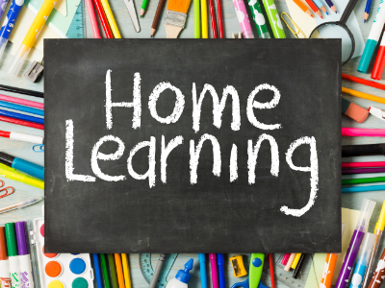
Reading expectations
5x a week at home- best for your child to read aloud to an adult
Spelling practise
Your child should practice the spelling list in their home learning books weekly
Times Tables Rock Stars
Your child should complete 20 minutes of TTRS a week- this is 20 minutes of garage
Books checked weekly
Please ensure your child brings in their home learning book with their completed spellings inside on Thursdays
They should have completed their 20 minutes of TTRS by Thursday too
Both your child’s reading record and their home learning book will be checked on a Thursday. Your child’s reading record will be returned on a Thursday and the home learning book on a Friday.

Slide 7
Key Year 6 information
SATs week- 12th May- 16th May 2025
Study aids – CPG Work books, study books
(Amazon about £5)
If child is walking home alone, they can bring their phone into school. This needs to be turned off and handed to me at the start of the day. I will give it back to them to walk home with.

Slide 8
Communication
SouthAmericaClass@sgmail.org.uk – contact me
ManorPrimary@sgmail.org.uk – contact school urgently/throughout the day
SLT on the gate in the morning- they can take messages which will be given directly to me in the morning
Whoever is teaching your child in the afternoon will be on the gate at the end of the day.
If you would like your child to walk home on their own, please let me know via email so that all adults are aware when sending the children out at the end of the day.

Slide 9
Thank you!

