Slide 1

Welcome to
Europe Class!

Slide 2

Your teaching team…
Mrs Pearce– Class Teacher
Mrs Wakefield – Class Teaching Assistant (Every morning except Tues)
Mrs Arnott - Class Teaching Assistant ( Mon- Wed morning)
Mr Prichard – PPA Cover (Wednesday mornings)

Slide 3
The Year ahead…
Term 1 – Mad about Maya
Term 2 – Burning Questions (Global warming focus)
Term 3 – Home sweet Habitat
Term 4 – It’s the sound of the Greeks!
Term 5 – The Shang dynasty.
Term 6 – What makes Bristol brilliant?

Slide 4
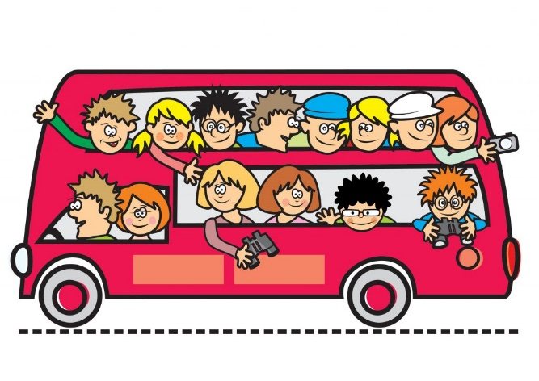
Trips!
Bristol Old Vic – Cinderella performance
The Bristol Zoo Project! Term 3 – Home sweet habitat!
Bristol Aerospace – Term 6 – What makes Bristol brilliant? Concorde focus.
We will inform you of the exact dates as and when trips have been confirmed.
Parent helpers will also be required.

Slide 5

Key information
Please ensure your child brings their reading
record and water bottle everyday.
Please ensure your child brings their Home learning books in every Thursday. Homework will then be marked, new sheets stuck in and sent back out on Fridays.
Please be reminded we are a NO NUTS school.
All uniform should be named.
PE kits – Gold top, black bottoms (shoes children can do up independently)
Hair tied back and all jewellery removed.
PE days are Wednesdays and Fridays.

Slide 6
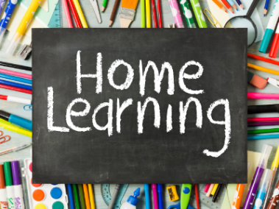
Children should be reading at home 5 times a week.
They should be reading aloud to an adult. This will enable them to read fluently and understand what they are reading.
Please talk to your child about the book they are reading and ask them questions where necessary.
Reading records in school everyday please –
checked and books changed Fridays.
Spelling practise (sheet in home learning
books.) Additional suggestions for practise.
Times table rockstars!
Home learning books in school on Thursday please and will be
returned Friday.

Slide 7
Communication
EuropeClass@sgmail.org.uk – direct email to me ☺
ManorPrimary@sgmail.org.uk
If urgent please email school, however I will check class emails daily.
SLT on gate in the morning.
I will be on the gate in the afternoon.

