Slide 1
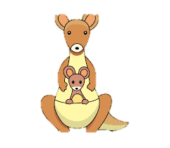
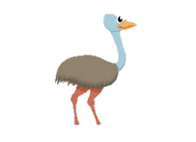
Welcome to
Australia Class!

Slide 2
Your teaching team…
Miss Hawkins – Class Teacher
Mrs Cox – Class Teaching Assistant (Every morning)
Mrs Wakefield - 1:1 LSA
Mrs Gray – PPA cover (RE, Tuesday PM)
Miss Lambe – PPA cover (PE, Tuesday PM)

Slide 3
The Year ahead…
Term 1 – Off with her head!
Term 2 – Remember, Remember
Term 3 – Extreme Earth (Robert Falcon Scott)
Term 4 – Rosa Parks
Term 5 – Wright Brothers
Term 6 – Ship Shape and Bristol Fashion

Slide 4
Trips!
4th October – Berkeley Castle
12th December – Pantomime @ Bristol Hippodrome
27th June – SS Great Britain

Slide 5
Key information
Please ensure your child brings their reading
wallet and water bottle everyday. (Not together) ☹
Children are provided with snacks so please do not send your
child in with these.
All uniform should be named.
PE kits – Gold top, black bottoms (shoes children can do up independently)
PE days are Tuesday and Friday

Slide 6
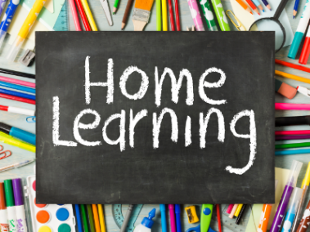
Children should be reading at home 5 times a week.
They should be reading each book 3 times. This will enable them to read fluently and understand what they are reading.
Talk about the book with your child.
Spelling practise – word lists are in each homelearning book. Practice writing each word. If confident, put into sentences.
Books checked weekly (We read with children every day but will count home reading on Thursdays)

Slide 7
Communication
Australiaclass@sgmail.org.uk
SLT on gate in the morning.
I will be on the gate in the afternoon.

